Slide 1
CSIT988/CSIT488 Security, Ethics and Professionalism Week 12: Personnel and security Law and Ethics
Subject Coordinator: Guangyou Zhou
School of Computing and Information Technology
Spring 2024

Slide 2
Week | Lecture Topics | Readings
1 | Introduction and overview of the subject | Chapter 1 / No Tutorials
2 | Information security management | Chapter 1
3 | Planning for security | Chapter 2
4 | Planning for contingencies | Chapter 3
5 | Information security policy | Chapter 4
7 | Developing the security program | Chapter 5
8 | Security management models & practices | Chapter 6, 7
9 | Risk management: identifying and accessing risk | Chapter 8
10 | Risk management: controlling risk | Chapter 9
11 | Protection mechanisms | Chapter 10
12 | Personnel and security, Law and Ethics | Chapter 11, 12
13 | Revision

Slide 3
Introduction
Maintaining a secure environment
Requires that the InfoSec department be carefully structured and staffed with appropriately credentialed personnel
Proper procedures must be integrated into all human resources activities
Including hiring, training, promotion, and termination practices

Slide 4
Staffing the Security Function
Selecting an effective mix of information security personnel
Requires consideration of several criteria
Some are within the control of the organization
Others are not
Supply and demand for personnel with critical information security skills
When demand rises quickly, initial supply often fails to meet it
As demand becomes known, professionals enter the job market or refocus their job skills to gain the required skills, experience, and credentials

Slide 5
Staffing the Security Function (cont’d.)
To move the InfoSec discipline forward, managers should:
Learn more about the requirements and qualifications for information security positions and relevant IT positions
Learn more about information security budgetary and personnel needs
Grant the information security function (and CISO) an appropriate level of influence and prestige

Slide 6
Qualifications and Requirements
Desired abilities for information security professionals
Understanding of how organizations are structured and operated
Recognizing that InfoSec is a management task that cannot be handled with technology alone
Work well with people and communicate effectively using both written and verbal communication
Acknowledging the role of policy in guiding security efforts

Slide 7
Qualifications and Requirements (cont’d.)
Desired abilities for information security professionals (cont’d.)
Understanding of the essential role of information security education and training
Helps make users part of the solution, rather than part of the problem
Perceive the threats facing an organization
Understand how these threats can become attacks, and safeguard the organization
Understanding how to apply technical controls

Slide 8
Qualifications and Requirements (cont.)
Desired abilities for information security professionals (cont’d.)
Demonstrated familiarity with the mainstream information technologies
Including Disk Operating System (DOS), Windows, Linux, and UNIX
Understanding of IT and InfoSec terminology and concepts

Slide 9
Information Security Positions
Types of Information security positions
Definers provide the policies, guidelines, and standards
People who consult, do risk assessment and develop the product and technical architectures
Senior people with a broad knowledge, but not a lot of depth
Builders are the real techies, who create and install security solutions
Those that administer the security tools, the security monitoring function, and the people who continuously improve the processes
Where all the day-to-day, hard work is done

Slide 10
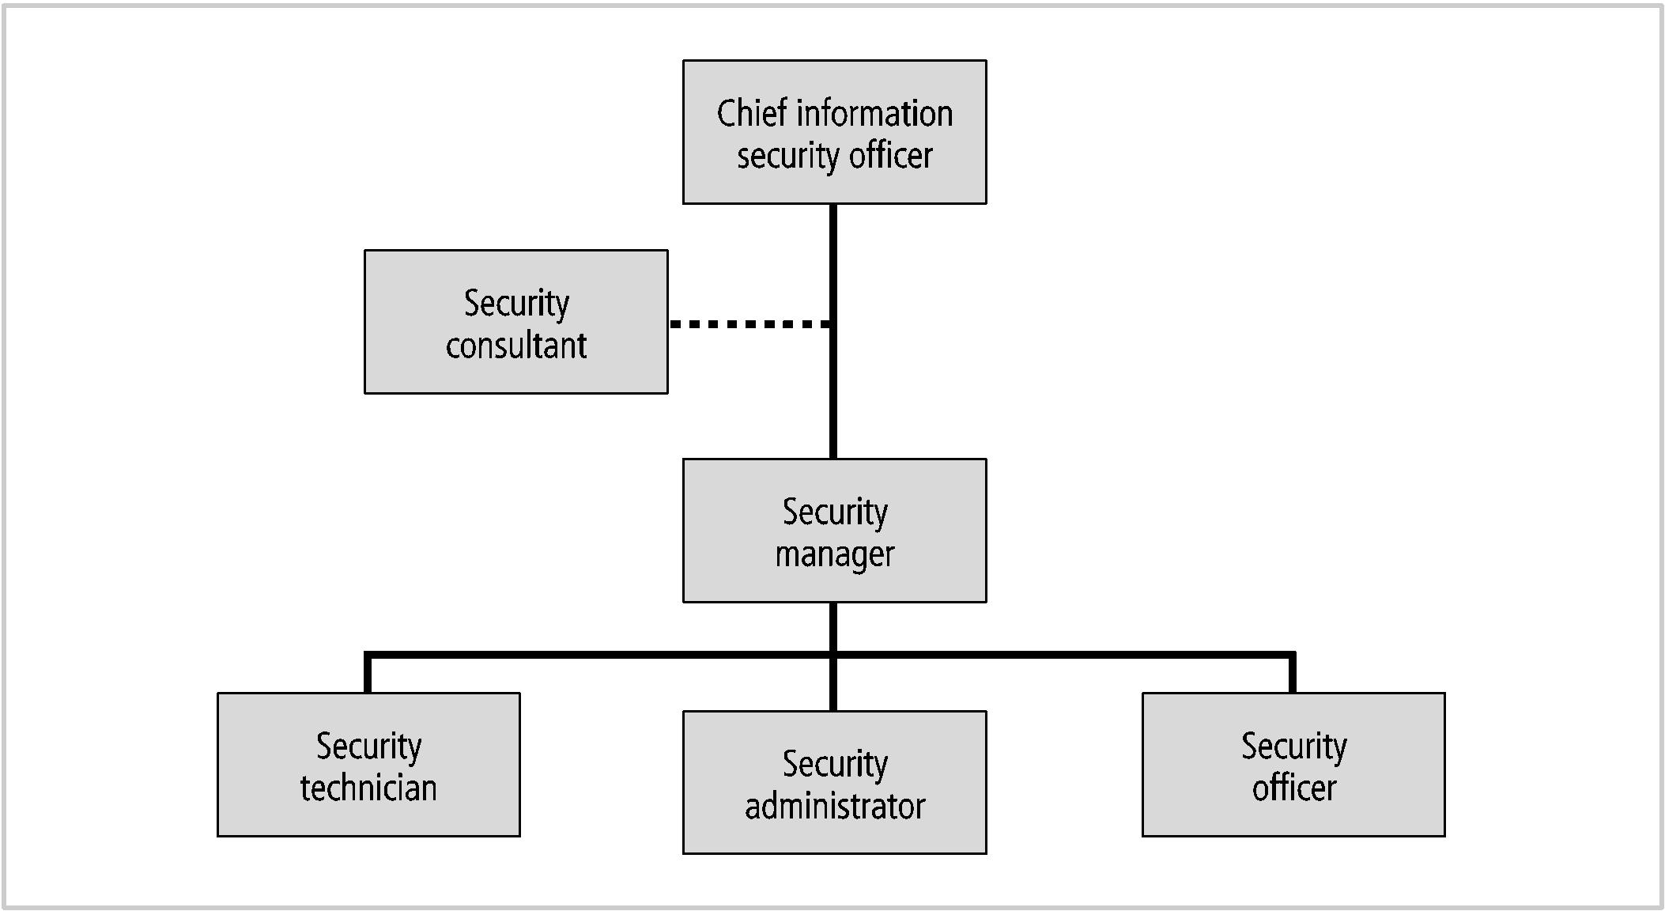
Information Security Positions (cont’d.)

Slide 11
Information Security Positions (cont’d.)
Chief Information Security Officer (CISO)
Typically considered the top information security officer in the organization
Usually not an executive-level position
Frequently reports to the CIO
Business managers first and technologists second
They must be conversant in all areas of information security
Including technology, planning, and policy

Slide 12
Information Security Positions (cont’d.)
Certified Information Systems Security Professional (CISSP)
Most common qualification for the CISO
A graduate degree in criminal justice, business, technology, or another related field is usually required for the CISO
CISO candidates should have experience in security management, planning, policy, and budgets

Slide 13
Information Security Positions (cont’d.)
Security Manager
It is not uncommon for a security manager to have a CISSP
Should have experience in traditional business activities, including budgeting, project management, personnel management, hiring and firing
Must be able to draft middle- and lower-level policies, as well as standards and guidelines
Several types exist, and the people tend to be much more specialized than CISOs

Slide 14
Information Security Positions (cont’d.)
Security technicians
Technically qualified individuals who configure firewalls and IDSs, implement security software, diagnose and troubleshoot problems, and coordinate with systems and network administrators to ensure that security technology is properly implemented
Typical information security entry-level position, albeit a technical one

Slide 15
Information Security Positions (cont’d.)
Technical qualifications and position requirements for a security technician vary
Organizations typically prefer expert, certified, proficient technicians
Job requirements usually includes some level of experience with a particular hardware and software package
Experience using the technology is usually required

Slide 16
Information Security Professional Credentials
Many organizations rely on professional certifications
To ascertain the level of proficiency possessed by any given candidate
Many certification programs are relatively new
Their precise value is not fully understood by most hiring organizations
Certifying bodies work to educate their constituent communities on the value and qualifications of their certificate recipients

Slide 17
(ISC)² Certifications
Certified Information Systems Security Professional
One of the most prestigious certifications
Recognizes mastery of domains of an internationally recognized InfoSec common body of knowledge
Access Control
Application Security
Business Continuity and Disaster Recovery Planning
Cryptography

Slide 18
(ISC)² Certifications (cont’d.)
Systems Security Certified Practitioner
More applicable to an entry-level security manager than a technician
Most questions focus on the operational InfoSec
Focuses on practices, roles, and responsibilities covering seven domains:
Access controls
Analysis and monitoring
Cryptography
Malicious code
Networks and Telecommunications
Risk, Response and Recovery
Security Operations and Administration

Slide 19
(ISC)² Certifications (cont’d.)
ISSAP®: Information Systems Security Architecture Professional
ISSEP®: Information Systems Security Engineering Professional
ISSMP®: Information Systems Security Management Professional

Slide 20
ISACA Certifications
Certified Information Systems Auditor
A certification of the Information Systems Audit and Control Association and Foundation
Appropriate for auditing, networking, and security professionals
Exam covers:
IS audit process (10 percent)
IT governance (15 percent)
Systems and infrastructure life cycle (16 percent)
IT service delivery and support (14 percent)
Protection of information assets (31 percent)
Business continuity and disaster recovery (14 percent)

Slide 21
ISACA Certifications (cont’d.)
Certified Information Security Manager (CISM)
Geared toward experienced information security managers
Assures executive management that a candidate has the required background knowledge needed for effective security management and consulting
Exam covers:
Information security governance (23 percent)
Information risk management (22 percent)
Information security program development (17 percent)
Information security program management (24 percent)
Incident management and response (14 percent)

Slide 22
Certification Costs
Preferred certifications can be expensive
Most experienced professionals find it difficult to do well on the exams without at least some review
Certifications recognize experts in their respective fields
The cost of certification deters those who might otherwise take the exam just to see if they can pass

Slide 23
Certification Costs (cont’d.)
Most examinations:
Require between two and three years of work experience
They are often structured to reward candidates who have significant hands-on experience

Slide 24
Employment Policies and Practices
Management should integrate solid information security concepts
Across all of the organization’s employment policies and practices
Including information security responsibilities into every employee’s job description and subsequent performance reviews
Can make an entire organization take information security more seriously

Slide 25
Hiring
From an information security perspective, hiring employees is laden with potential security pitfalls
Information security considerations should become part of the hiring process
Job descriptions
Provide complete job descriptions when advertising open positions

Slide 26
Hiring (cont’d.)
Interviews
Information security should advise human resources
Limit the information provided to the candidates on the access rights of the position
When an interview includes a site visit
Tour should avoid secure and restricted sites, because the visitor could observe enough information about the operations or information security functions to represent a potential threat to the organization

Slide 27
Hiring (cont’d.)
New hire orientation
New employees should receive an extensive information security briefing
As part of their orientation
On-the-job security training
Conduct periodic SETA activities
Keeps security at the forefront of employees’ minds and minimizes employee mistakes
Security checks
Conduct a background check before extending an offer

Slide 28
Termination Issues
When an employee leaves an organization, the following tasks must be performed:
Disable access to the organization’s systems
Return all removable media
Hard drives must be secured
File cabinet and door locks must be changed
Keycard access must be revoked
Personal effects must be removed
Escort the former employee from the premises
Notes:
http://www.cio.com/article/481883/More_Than_Half_of_Fired_Employees_Steal_Data
http://www.sgrlaw.com/resources/trust_the_leaders/leaders_issues/ttl17/827/

Slide 29
Termination Issues (cont’d.)
Many organizations conduct an exit interview
To remind the employee of any contractual obligations
Such as nondisclosure agreements
To obtain feedback on the employee’s tenure in the organization
Methods for handling employee outprocessing: hostile and friendly

Slide 30
Termination Issues (cont’d.)
Hostile departure
Security cuts off all logical and keycard access before the employee is terminated
The employee reports for work, and is escorted into the supervisor’s office to receive the bad news
The individual is then escorted from the workplace and informed that his or her personal property will be forwarded, or is escorted to his or her office, cubicle, or personal area to collect personal effects

Slide 31
Termination Issues (cont’d.)
Friendly departure
The employee may have tendered notice well in advance of the actual departure date
Difficult for security to maintain positive control over the employee’s access and information usage
Employee accounts are usually allowed to continue, with a new expiration date
The employee can come and go at will
Usually collects any belongings and leaves without escort, dropping off all organizational property before departing

Slide 32
Termination Issues (cont’d.)
In either circumstance:
Offices and information used by departing employees must be inventoried, their files stored or destroyed, and all property returned to organizational stores
Departing employees may have collected and taken home information or assets that could be valuable in their future jobs
Scrutinizing system logs may allow an organization to determine whether a breach of policy or a loss of information has occurred

Slide 33
Personnel Security Practices
Methods of monitoring and controlling employees
To minimize their opportunities to misuse information
Separation of duties is used to make it difficult for an individual to violate information security and breach the confidentiality, integrity, or availability of information
Two-man control requires that two individuals review and approve each other’s work before the task is considered complete

Slide 34
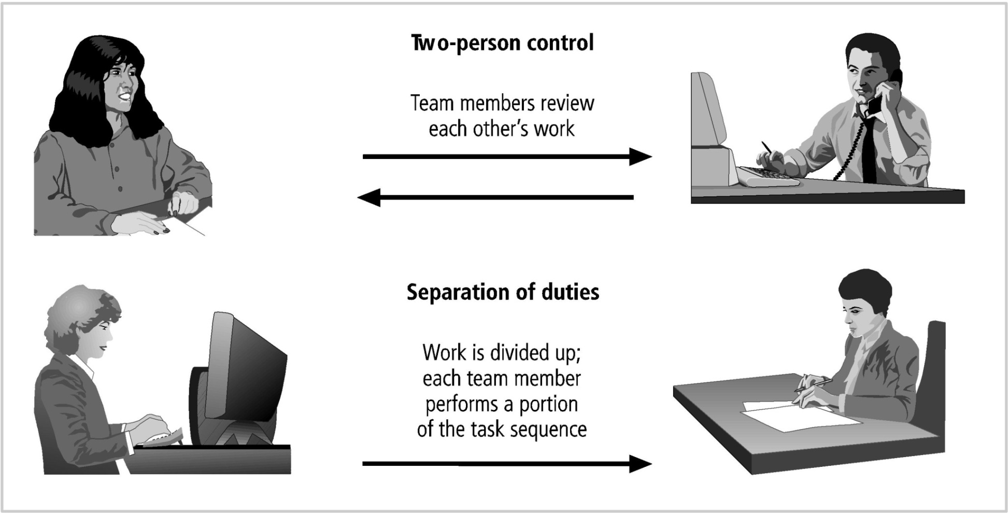

Slide 35
Personnel Security Practices (cont’d.)
Methods of monitoring and controlling employees (cont’d.)
Job rotation is another control used to prevent personnel from misusing information assets
Requires that every employee be able to perform the work of at least one other employee
Task rotation
All critical tasks can be performed by multiple individuals

Slide 36
Personnel Security Practices (cont’d.)
Job rotation and task rotation ensure
No one employee is performing actions that cannot be knowledgeably reviewed by another employee
Each employee should be required to take mandatory vacation
This policy gives the organization a chance to perform a detailed review of everyone’s work

Slide 37
Personnel Security Practices (cont’d.)
Limiting access to information
Minimizes opportunities for employee misuse
Employees should be able to access only the information they need, and only for the period required to perform their tasks
This idea is referred to as the principle of least privilege
Ensures that no unnecessary access to data occurs
If all employees can access all the organization’s data all the time, it is almost certain that abuses will occur

Slide 38
Security of Personnel and Personal Data
Organizations are required by law to protect sensitive or personal employee information
Examples: employee addresses, phone numbers, Social Security numbers, medical conditions, and names and addresses of family members
Responsibility extends to customers, patients, and anyone with whom the organization has business relationships

Slide 39
Security of Personnel and Personal Data (cont’d.)
Personnel data is no different than other data that information security is expected to protect
But more regulations cover its protection
Information security procedures should ensure that this data receives at least the same level of protection as the other important data in the organization

Slide 40
Security Considerations for Nonemployees
Many individuals who are not employees often have access to sensitive organizational information
Relationships with individuals in this category should be carefully managed to prevent threats to information assets from materializing
Temporary workers
Not employed by the organization for which they’re working

Slide 41
Security Considerations for Nonemployees (cont’d.)
Temporary workers (cont’d.)
May not be subject to the contractual obligations or policies that govern employees
Unless specified in its contract with the organization, the temporary agency may not be liable for losses caused by its workers
Access to information should be limited to what is necessary to perform their duties

Slide 42
Security Considerations for Nonemployees (cont’d.)
Contract employees
Professional contractors may require access to all areas of the organization to do their jobs
Service contractors usually need access only to specific facilities
Should not be allowed to wander freely
In a secure facility, all service contractors are escorted from room to room, and into and out of the facility

Slide 43
Security Considerations for Nonemployees (cont’d.)
Regulations for service agreements or contracts:
Require 24 to 48 hours’ notice of a maintenance visit
Require all on-site personnel to undergo background checks
Require advance notice for cancellation or rescheduling of a maintenance visit

Slide 44
Security Considerations for Nonemployees (cont’d.)
Consultants
Have their own security requirements and contractual obligations
Should be handled like contract employees
Special requirements, such as information or facility access requirements, should be integrated into the contract before facility access is granted
Protecting your information may not be their number one priority
Apply the principle of least privilege

Slide 45
Security Considerations for Nonemployees (cont’d.)
Business partners
Strategic alliances with other organizations to exchange information, integrate systems, or enjoy some other mutual advantage
A prior agreement must specify the levels of exposure that both organizations are willing to tolerate
Security and technology consultants must be prescreened, escorted, and subjected to nondisclosure agreements

Slide 46
Security Considerations for Nonemployees (cont’d.)
Business partners (cont’d.)
If the strategic partnership evolves into an integration of the systems of both companies
Competing groups may be provided with information that neither parent organization expected
Nondisclosure agreements are an important part of any such collaborative effort
Security level of both systems must be examined before any physical integration takes place
A vulnerability on one system becomes vulnerability for all linked systems

Slide 47
Law & Ethics in InfoSec
Laws: are rules adopted and enforced by governments to codify expected behavior in modern society
Ethics: acceptable behaviors that conform to the widely held principles of the members of that society
Laws are largely drawn from the ethics of a culture.
Law carries the sanction of a governing authority and ethics do not.

